Slide 1


2024 4th ASIAN CONFERENCE ON INNOVATION IN TECHNOLOGY (ASIANCON 2024)
Exploring the Impact of Image Filters in Facial Detection Through Different Classification Algorithms
Paper ID: 1528
Akshay Kumar Joshi
Department of Mathematics, Graphic Era Hill University,
Dehradun

Slide 2
Contents
Objective
Introduction
Methodology
Results
Conclusion
References

Slide 3
Objective
In this study, we created multiple datasets to evaluate the performance of various machine learning algorithms. The first dataset comprises 1,600 unfiltered images of eight students, with 200 images per student. A second dataset contains 8,000 images, filtered using a mix of techniques, with 1,000 images per student. Additionally, five distinct datasets were generated by applying individual filters .We have used Paired t-test to check whether the accuracy scores of different classification algorithms for Unfiltered and filtered datasets are identical or not. Various filters used for the study are blur, cut-out, mosaic, noise, and shear.

Slide 4
Introduction
Face detection is a technology used in computer vision that identifies and locates human faces in digital images or video streams. It involves detecting the presence and position of a face, distinguishing it from other objects in the image.
These are the following algorithms that we have used in our Research article:
Convolutional Neural Network (CNN)
Random Forest
Support Vector Machine (SVM)
Naïve Bayes
Logistic Regression
K-Nearest Neighbors (KNN)

Slide 5
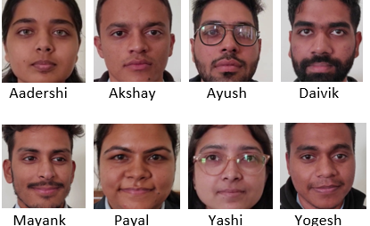
Methodology
In this Research Article, we have taken the images of eight students using OpenCV as shown in Fig.1. Using these images, a dataset of 1600 images has been created, with 200 images of each student. These are coloured images of size 128 x 128.
Fig. 1. Image of students whose data has been collected

Slide 6
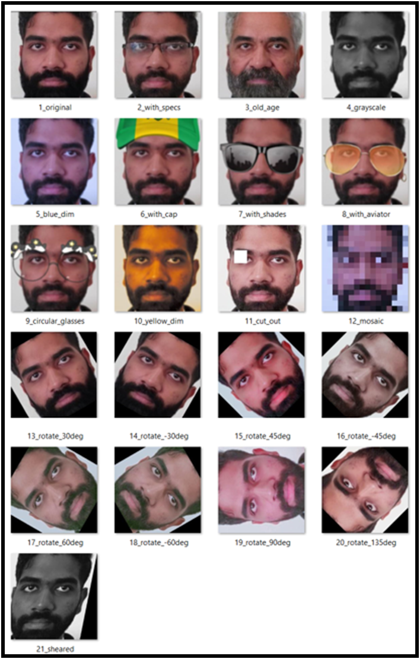
After that we have applied the filters on the images of the student and generated another dataset, we have applied the filters like shear, grayscale, cut-out, hue, saturation, brightness, exposure, blur, noise, mosaic, old, with specs and few more. Some other filters involve rotation of images at various angles including 30, 45, 60, 120, 135, -30, - 60, -45, -135 etc. as sample image which is shown in Fig. 2.
Each class include 1000 images of size 128x128.
Fig. 2. Sample of Filtered Images

Slide 7
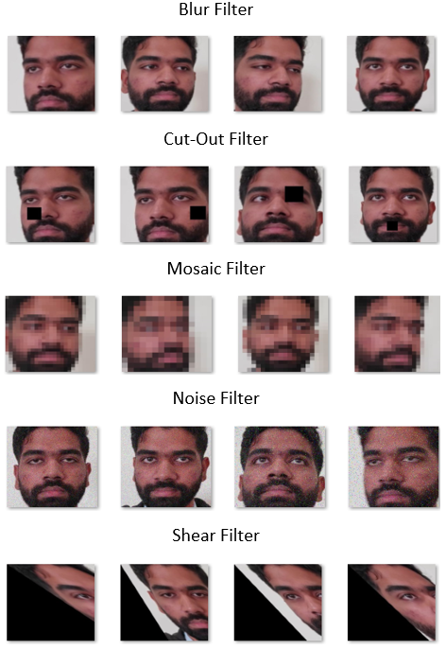
We have created 5 more dataset to compare the effect of individual filters on the unfiltered dataset.
These datasets have been created by applying the filters on the original dataset keeping the size of each dataset equal.
We have used the filters namely blur, cut-out, mosaic, noise and shear shown in Fig.3.
Each dataset consists of 200 images per student that is we have a total of 1600.
Fig. 3. Sample of Individual Filtered Images

Slide 8
Some of previous work in face recognition includes:
Identification of student and recording attendance [1]
Criminal investigation by matching faces and security purposes [3]
Study of facial landmark for face detection [5]
Facial feature with skin color segmentation for face detection [6]
Deep learning models for face detection [7]
Face mask detector using YOLOV3 and DeepMaskNet models [9]

Slide 9
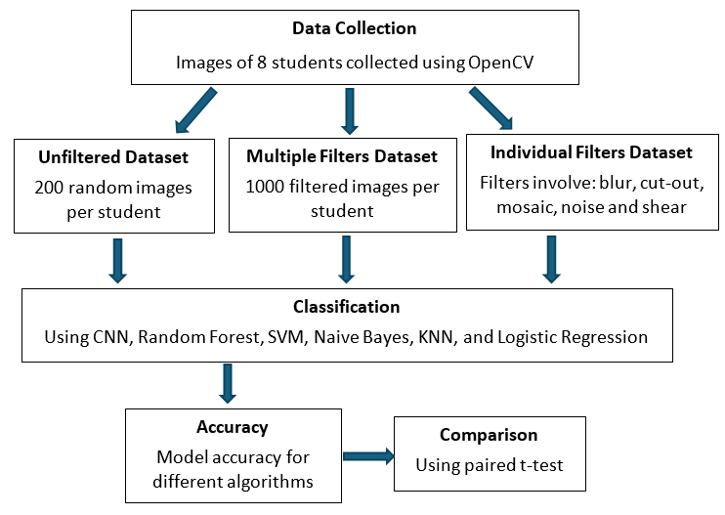
Flowchart of the Work Process

Slide 10

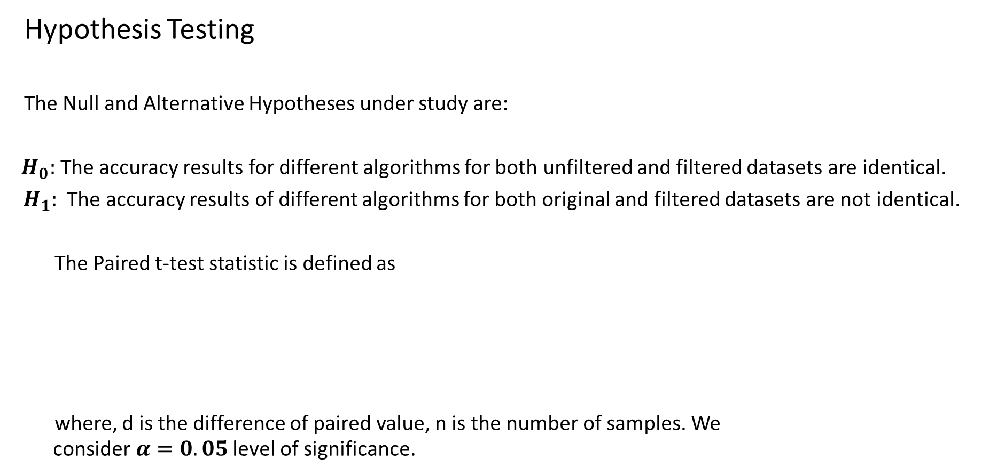
Hypothesis Testing
The Null and Alternative Hypotheses under study are:
$H_{0}:$ The accuracy results for different algorithms for both unfiltered and filtered datasets are identical.
${ H}_{1}:$ The accuracy results of different algorithms for both original and filtered datasets are not identical.
The Paired t-test statistic is defined as
where, d is the difference of paired value, n is the number of samples. We consider$α=0.05$ level of significance.

Slide 11
Results
TABLE I: Accuracy of different algorithms
Algorithm | Unfiltered dataset | Mixed filtered dataset
CNN | 0.9938 | 0.9981
Random Forest | 1.00 | 0.9993
SVM | 1.00 | 0.9993
Naïve Bayes | 0.9406 | 0.9118
KNN | 0.9969 | 0.9987
Logistic Regression | 1.00 | 0.9987

Slide 12
TABLE II: Algorithm accuracy for individual filter datasets
Algorithm | Un-filtered dataset | Blur | Cut-out | Mosaic | Noise | Shear
CNN | 0.99 | 0.99 | 0.99 | 0.99 | 0.99 | 0.96
Random Forest | 1.00 | 1.00 | 1.00 | 1.00 | 0.97 | 0.97
SVM | 1.00 | 0.99 | 0.99 | 0.99 | 0.99 | 0.98
Naïve Bayes | 0.94 | 0.91 | 0.89 | 0.95 | 0.94 | 0.65
KNN | 0.99 | 0.99 | 0.99 | 0.99 | 0.99 | 0.81
Logistic Regression | 1.00 | 0.99 | 0.99 | 0.99 | 0.99 | 0.97

Slide 13
TABLE III: Results of Paired t-test
Filters | t-statistic | p-value
Blur | 2.714 | 0.042
Cut-out | 1.312 | 0.246
Mosaic | -0.168 | 0.875
Noise | 2.043 | 0.096
Shear | 2.048 | 0.095
Mixed filtered dataset | 0.848 | 0.43

Slide 14
Conclusions:
Through our study, we found that
There is no significant difference between original dataset and mix of filters dataset.
In general mix of filters dataset, do not have much effect in face detection through different classification algorithms
When paired t-test is applied between individual filter dataset and original dataset, among 5 filters ‘blur’ filter has shown significant difference when compared to original dataset at 5% level of significance.

Slide 15
Future Work
Work with more filters, so that we can provide more generalized statement.
Explore additional image processing techniques beyond the filters studied here to further investigate their impact on face detection accuracy.
Conduct a comparative analysis with different datasets containing diverse facial expressions, lighting conditions, and backgrounds to generalize the findings across various scenarios.

Slide 16
References:
[1] Prof. S. Ahire, R. Jadhao, V. Gawai, and P. Giri, “Automated Student Attendance Management System Using Face Recognition,” International Journal of Advanced Research in Science, Communication and Technology, 2021, doi: 10.48175/ijarsct-2019.
[2] A. Khan, I. khan, J. Golandaj, A. George, and S. Bhandari, “A Survey on Automated Student Attendance Management System Using Face Recognition,” International Journal of Research Publications, vol. 122, no. 1, 2023, doi: 10.47119/ijrp1001221420234626.
[3] L. F. Huang et al., “Criminal Investigation with the help of Face Recognition,” International Journal of Engineering Research & Technology (IJERT), vol. 2, no. 6, 2021.
[4] N. S. Irjanto and N. Surantha, “Home Security System with Face Recognition based on Convolutional Neural Network,” International Journal of Advanced Computer Science and Applications, vol. 11, no. 11, 2020, doi: 10.14569/IJACSA.2020.0111152.
[5] S. Saleem, J. Shiney, B. Priestly Shan, and V. Kumar Mishra, “Face recognition using facial features,” Mater Today Proc, vol. 80, 2023, doi: 10.1016/j.matpr.2021.07.402.

Slide 17
[6] S. Yadav and N. Nain, “A novel approach for face detection using hybrid skin color model,” J Reliab Intell Environ, vol. 2, no. 3, 2016, doi: 10.1007/s40860-016-0024-8..
[7] A. Sharma, R. Gautam, and J. Singh, “Deep learning for face mask detection: a survey,” Multimed Tools Appl, vol. 82, no. 22, 2023, doi: 10.1007/s11042-023-14686-6.
[8] Q. M. Ilyas and M. Ahmad, “An enhanced deep learning model for automatic face mask detection,” Intelligent Automation and Soft Computing, vol. 31, no. 1, 2022, doi: 10.32604/IASC.2022.018042.
[9] X. Jiang, T. Gao, Z. Zhu, and Y. Zhao, “Real-time face mask detection method based on yolov3,” Electronics (Switzerland), vol. 10, no. 7, 2021, doi: 10.3390/electronics10070837.
[10] N. Ullah, A. Javed, M. Ali Ghazanfar, A. Alsufyani, and S. Bourouis, “A novel DeepMaskNet model for face mask detection and masked facial recognition,” Journal of King Saud University - Computer and Information Sciences, vol. 34, no. 10, 2022, doi: 10.1016/j.jksuci.2021.12.017.
[11] H. A. Rowley, S. Baluja, and T. Kanade, “Neural networkbased face detection,” IEEE Trans Pattern Anal Mach Intell, vol. 20, no. 1, 1998, doi: 10.1109/34.655647.
[12] S. Saleem, J. Shiney, B. Priestly Shan, and V. Kumar Mishra, “Face recognition using facial features,” Mater Today Proc, vol. 80, 2023, doi: 10.1016/j.matpr.2021.07.402.

Slide 18
[13] N. Abudarham, L. Shkiller, and G. Yovel, “Critical features for face recognition,” Cognition, vol. 182, 2019, doi: 10.1016/j.cognition.2018.09.002.
[14] S. Benini, K. Khan, R. Leonardi, M. Mauro, and P. Migliorati, “Face analysis through semantic face segmentation,” Signal Process Image Commun, vol. 74, 2019, doi: 10.1016/j.image.2019.01.005.
[15] S. Yadav and N. Nain, “A novel approach for face detection using hybrid skin color model,” J Reliab Intell Environ, vol. 2, no. 3, 2016, doi: 10.1007/s40860-016-0024-8

Slide 19
Thank you !

